Slide 1
TCP Congestion Control Scheme for Wireless Networks based on TCP Reserved Field and SNR Ratio
Presented by Hasan Masum(1805052)

Slide 2

Reference
Paper: TCP Congestion Control Scheme for Wireless Networks based on TCP Reserved Field and SNR Ratio
Author: Youssef Bassil,
LACSC – Lebanese Association for Computational Sciences
Journal: International Journal of Research and Reviews in Information Sciences (IJRRIS)
Year: 2012

Slide 3
Motivation
Solve TCP performance problem over wireless networks.
Take the right decision in situations where timeouts were due to error and not to congestion, that is retransmitting the timed-out packet instead of reducing the congestion window size.
1
3
2
Allow the TCP protocol to differentiate between timeouts caused by congestion and those caused by errors and noise in the wireless channel.
4
Stop the reduction of the burst of the packet and increase packet throughput and transmission speed.

Slide 4
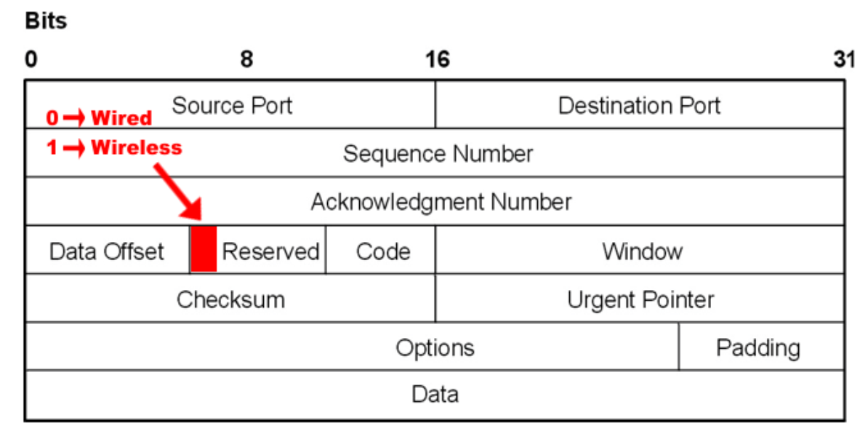
Proposed solution
Reserved bit
Use one single bit of the reserved bits of the TCP header to indicate the type of the link over which connection is established.
Reserve bit = 0 for wired mode.
Reserve bit = 1 for wireless mode.
Therefore the proposed algorithm works for both wired and wireless network environments.

Slide 5
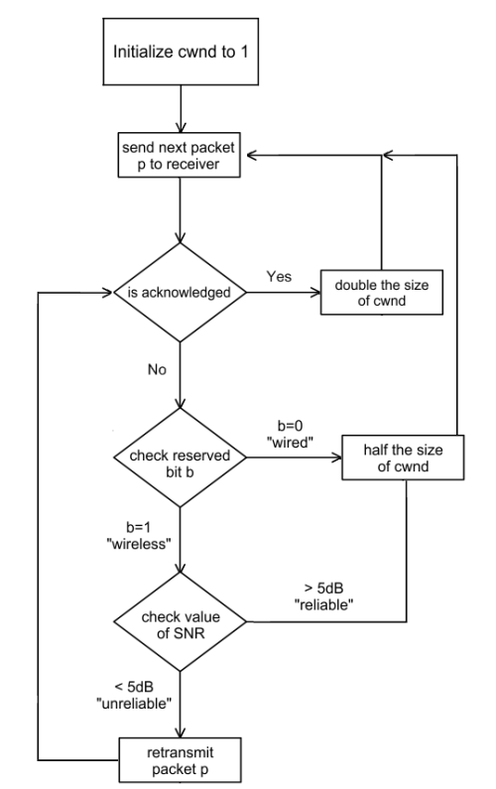
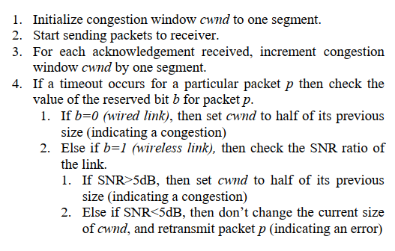
Proposed solution
Pseudo-code

Slide 6
Thank you.

